Slide 1

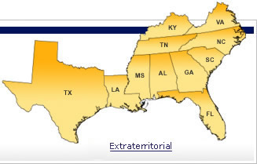

The Naval Aviator Flyby
Ken Scott, Ed.D.
H. Councill Trenholm State Technical College
Professional Development
30 January 2009
SACS-COC
1

Slide 2

Accrediting Agencies = baseline to grow
Accreditation Commission for Acupuncture and Oriental Medicine (ACAOM)
Accrediting Bureau of Health Education Schools (ABHES)
Accrediting Commission of Career Schools and Colleges of Technology (ACCSCT)
Accrediting Council for Continuing Education and Training (ACCET)
Accrediting Council for Independent Colleges and Schools (ACICS)
American Dental Association Commission on Dental Accreditation (CODA)
Commission on Colleges of the Southern Association of Colleges and Schools (SACS-COC)
Commission on Massage Therapy Accreditation (COMTA)
Council on Occupational Education (COE)
Distance Education and Training Council (DETC)
Higher Learning Commission (HLC)
Middle States Commission on Higher Education (MSCHE)
National Accrediting Commission of Cosmetology Arts and Sciences (NACCAS)
New England Association of Schools and Colleges (NEASC)
Northwest Commission on Colleges and Universities (NWCCU)
Western Association of Schools and Colleges (WASC)
2

Slide 3

SACS - COC
MISSION STATEMENT OF THE COMMISSION
The Commission on Colleges of the Southern Association of Colleges and Schools is the regional body for the accreditation of degree‐granting higher education institutions in the Southern states.
The Commission’s mission is the enhancement of educational quality throughout the region and it strives to improve the effectiveness of institutions by ensuring that institutions meet standards established by the higher education community that address the needs of society and students.
It serves as the common denominator of shared values and practices among the diverse institutions in Alabama, Florida, Georgia, Kentucky, Louisiana, Mississippi, North Carolina, South Carolina, Tennessee, Texas, Virginia and Latin America and other international sites approved by the Commission on Colleges that award associate, baccalaureate, master’s, or doctoral degrees. The Commission also accepts applications from other international institutions of higher education.
Revised: Commission on Colleges, June 2008
3

Slide 4

IS THERE ANY SUPPORT FOR ACCREDITATION?
Dodd, A. (2004). Accreditation as a catalyst for institutional effectiveness. New Directions for Institutional Research, 123, 13-25.
Eaton, J. (October, 2007). Institutions, accreditors, and the federal government: Redefining their “appropriate relationship.” Change, September/October 2007, 16-23.
Biswas, R. (2006). A supporting role: How accreditors can help promote the success of community college students. An Achieving the Dream Policy Brief, 1-24.
Ad infinitum……..
Internet Search for “Community College Accreditation” = 255,000 hits
Internet Search for “College Accreditation” = 259,000 hits
There is a growing sense, among institutions and accrediting bodies alike, that accreditation would benefit from moving toward an ongoing process of continuous improvement based on a culture of evidence, built around the central themes of student learning and student success. This shift from a periodic, discontinuous seminal event will require a parallel [paradigm] shift from a compliance framework to an improvement framework, with data driving the undertaking. (Biswas, 2006, p. 20)
Translation = do, documentation trail, and improve student outcomes
4

Slide 5

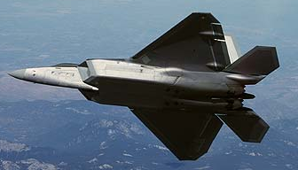
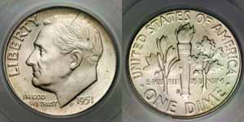

With the vast discussion on accreditation issues, accrediting agencies, student success, and accountability… what does it mean to TrenholmTech?
New
Paradigm
Old
Paradigm
5

Slide 6
A Bit of Reality
2008 – 2009 Proration of 9% (+/- an additional percentage)
2009 – 2010: Potential Shortfall from 2009:
Between $700 Million and $1 Billion
(Alabama School Journal, January 19, 2009)
Student enrollment = institutional funds
Increased enrollment = increased funds
6% for 5 years assuming a student body of 1500 would be ➔ 2007 Students
SACS-COC = “recruitable transferability”
“Recruitable transferability” = potential students
6

Slide 7
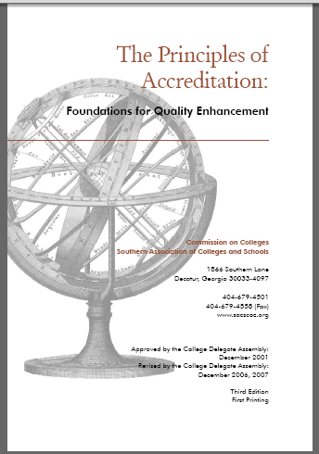
How do we achieve “recruitable transferability”…
http://www.sacscoc.org/principles.asp
Core Requirements
2008 EDITION
Comprehensive Standards
7

Slide 8
First, we meet the Principles of Accreditation, Core Requirements
Core Requirements are basic, broad-based, foundational requirements that an institution must meet to be accredited with the Commission on Colleges. They establish a threshold of development required of an institution seeking initial or continued accreditation by the Commission and reflect the Commission’s basic expectations of candidate and member institutions. Compliance with the Core Requirements is not sufficient to warrant accreditation or reaffirmation of accreditation. Accredited institutions must also demonstrate compliance with the Comprehensive Standards and the Federal Requirements of the Principles, and with the policies of the Commission. Examples….
2.1 The institution has degree-granting authority from the appropriate government agency or agencies. (Degree-granting Authority)
2.4 The institution has a clearly defined, comprehensive, and published mission statement that is specific to the institution and appropriate for higher education. The mission addresses teaching and learning and, where applicable, research and public service. (Institutional Mission Statement)
8

Slide 9

What are the core requirements?
www.sacscoc.org
Core Requirement One – Degree Granting Authority
Core Requirement Two – Governing Board
Core Requirement Three – Chief Executive Officer
Core Requirement Four – Institutional Mission
Core Requirement Five – Research-Based Planning and Evaluation: Institutional Effectiveness
Core Requirement Six – Continuous Operations
Core Requirement Seven – Degree Programs: (a) 60 semester hours (b) Coherent course of study (c) Substantial and appropriate gen ed component (d) Breadth of knowledge from gen ed (e) Coherent rationale for gen ed (f) Instruction of other institutions
Core Requirement Eight - Faculty
Core Requirement Nine – Library Resources
Core Requirement Ten – Student Support Services
Core Requirement Eleven – Sound Financial Base
Faculty Credentials
Gen Ed Competencies
Programmatic Student Learning Outcomes
Federal Regs
4.1 – Course completion, licensure, job placement
4.2 – Curriculum related to purpose and goals
4.3 – Calendar, grading policies, refund policies
4.4 – Program length
4.5 – Student complaints
4.6 – Recruitment materials
4.7 – Title IV
9

Slide 10
Next, we meet the Principles of Accreditation, Comprehensive Standards
The Comprehensive Standards set forth requirements in the following four
areas:
institutional mission, governance, and effectiveness;
programs;
(3) resources; and
(4) institutional responsibility for Commission policies.
The Comprehensive Standards are more specific to the operations of the institution, represent good practice in higher education, and establish a level of accomplishment expected of all member institutions. If an institution is judged to be significantly out of compliance with one or more of the Comprehensive Standards, its reaffirmation of accreditation may be denied. (See Commission policy “Sanctions, Denial of Reaffirmation, and Removal from Membership.”) A candidate institution is required to document compliance with Core Requirements 2.1-2.11 and all the Comprehensive Standards and Federal Requirements in order to be awarded initial membership.
10

Slide 11
SO, what are the Comprehensive Standards?
Comprehensive Standards
3.1 Institutional Mission
3.2 Governance and Administration
3.3 Institutional Effectiveness
3.4 All Educational Programs
3.5 Undergraduate Programs
3.6 Graduate and Post-Baccalaureate Professional Programs
3.7 Faculty
3.8 Library and Other Learning Resources
3.9 Student Affairs and Services
3.10 Financial Resources
3.11 Physical Resources
3.12 Substantive Change Procedures and Policy
3.13 Compliance with Other Commission Policies
3.14 Representation of Accreditation Status
11

Slide 12
Expected Outcomes of SACS-COC?
Can you think of others?
Improvements in Institutional Effectiveness
Enhanced Student Outcomes and Success
Opportunities for Professional Development
Community Services & Support
Degree Transfer-Articulation
Workforce Development
Greater Potential for Enrollment/Retention
12

Slide 13
THEREFORE, our Individual and Collective Paradigm Shift will be?????
New
Paradigm
???????????
Old
Paradigm
????????????
13

Slide 14

Thanks…this completes the Flyby…
And…now,
heeeeeeeeeeeeeeeeeeeeeeeeeeeere’s
Sharon Watts!!!
14

